Slide 1

Digital Image Processing Lecture Geometric Transformation

Slide 2
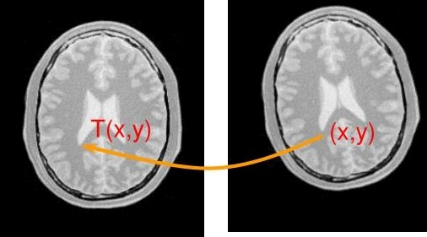
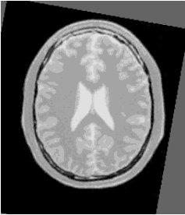
Review
A geometric transform of an image consists of two
basic steps
u Step1: determining the pixel so-ordinate transformation
a Step2: determining the brightness of the points in the digital
grid.
In the previous lecture, we discussed brightness interpolation and some variations of affine transformation.
2

Slide 3
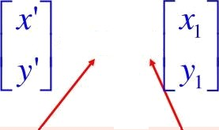
Af£ine Transformation (con'd)
An añine transformation is equivalent to the composed effects of translation, rotation and scaling.
The general affine transformation is commonly expressed as below:
——B + A
O^{th} order coefficients |  | 1st order coefficients

Slide 4
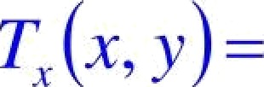




General Formulation
A geometric transform is a vector function T that maps the pixel (x,y) to a new position (x’,y’):
x —— T (x, y) y = T (x, y)
T,(x,y) and Tp(x,y) are usually polynomial equations.
ni m—r iii ni —r
T (x, y$ ——
r ——O k ——O r ——D k ——D
This transform is linear with respect to the
coefficients a_{rk} and b,_{k}.

Slide 5
! Finding Coefficients
How to find a_{rk} and b_{r}a,which are often
unknown?
a Finding pairs of corresponding points (x,y), (x’,y’) in both images,
a Determining a_{rk} Andb_{rk} by solving a set of linear
equations.
a More points than coeñicients are usually used to get robustness. Least-squares fitting is often used.

Slide 6
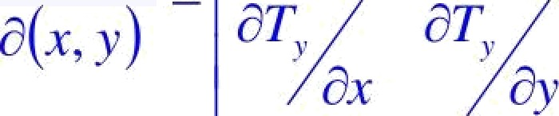
/acobian
A geometric transform applied to the whole image may change the co-ordinate system, and a Jacobian J provides information about how the co-ordinate system changes
dT, pq âT,
k T, ,T )
J!x, v) ——
The area of the image is invariant if and only if |J|=1 (|J| is the determinant of J).
What is the Jacobian of an affine transform?

Slide 7
Variation of Affine (2D)
Translation: displacement
T, (x, y) = x+ o()() T $x, y) = y + b„„
Euclidean (rigid): translation + rotation
T,(x• 1)' aoo + xcos Q + y sin Q
T $x, y)=big — x sY + y cos
Similarity: Euclidean + scaling
T,(x, y) = a_{ux}+ s,{xcos
T„(x, y) boo +„s(—xsin
(for isotropic scaling, sx = sy)
+ y sÙ
+ y cos

Slide 8



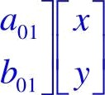
iTypes of transformations (2D)
Affine: Similarity + shearing
T, $x, y) ——app + a, x+ a , y
T (x, y) = bqq + b_{lo*}+bp
a Some illustrations of shearing effects (courtesy of Luis Ibanez)

Slide 9



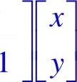

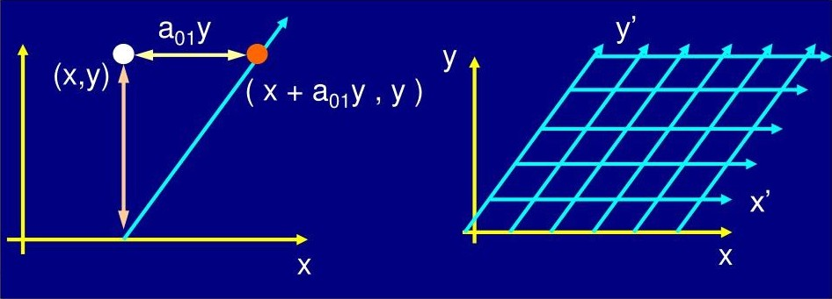
Affine transform
a Shearing in x-direction
‘01
9

Slide 10
Affine transform
a Shearing in y-direction

Slide 11
Invariant Properties
Translation:
Euclidean:
Similarity:
Affine:

Slide 12
iTypes of transformations (2D)
Bilinear: Affine + warping
T, (x, y)= app + ‹i₁ x + i;,₁y + a_{I I}x j
T (x, y) ——b;;, + b„x + b,› + b, ,x y
Quadratic: Affine + warping
T, $x, y)
T (x, y)
2 2
a„ + a„x + al_{l}y + a, ,x y+ a₂ x + ri ₂ y
2 2
b„ + b_{l} x + b„y +b,,xy+b₂ x +b ₂ y

Slide 13

Least-Squares Estimation
Because of noise in the images, if there are more correspondence pairs than minimally required, it is often not possible to find a transformation that satisfies all pairs.
Objective: To minimize the sum of the Euclidean distances of the correspondence set C={P:_{«ml} where _{P=}{x y:), and q; is the corresponding point.
QT$ p ;8) q,
,
1s

Slide 14




Least-Squares Estimation - Affine
For aPine model, 8 = I«, ,bq„ «„ « b q b ]^{T}
0
01 l 0
The Euclidean error e, X,8 —q,
, where
0
1
_{p} T
!!gT
With the new notation,
F(8•,C) ——
To find g which minimize y(e,c) we want
kF ₌ ₀
14

Slide 15
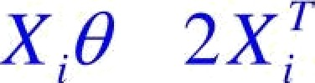




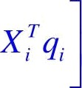


Least-Squares Estimation - Affine
This leads to
T
g ] 0
Therefore,

Slide 16
Some remarks
So far, we only discussed global transformation (applied to entire image)
It is possible to approximate complex geometric transformations (distortion) by partitioning an image into smaller rectangular sub-images.
for each sub-image, a simple geometric transformation, such as the affine, is estimated using pairs of corresponding pixels.
geometric transformation (distortion) is then performed separately in each sub-image.

Slide 17
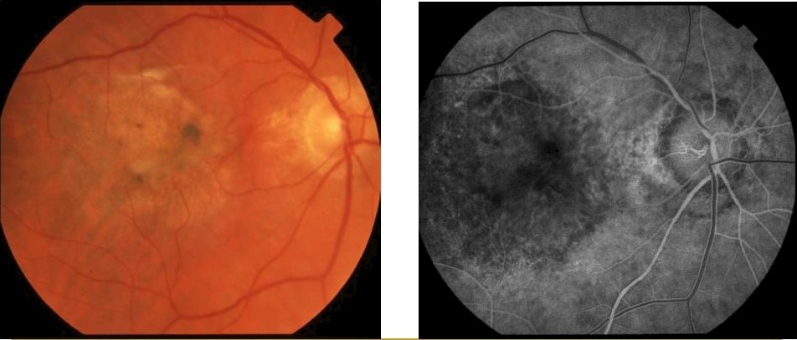
Real Application
Registration of retinal images of different modalities
Importance?
Color slide
Fluorocein Angiogram ,,

Slide 18
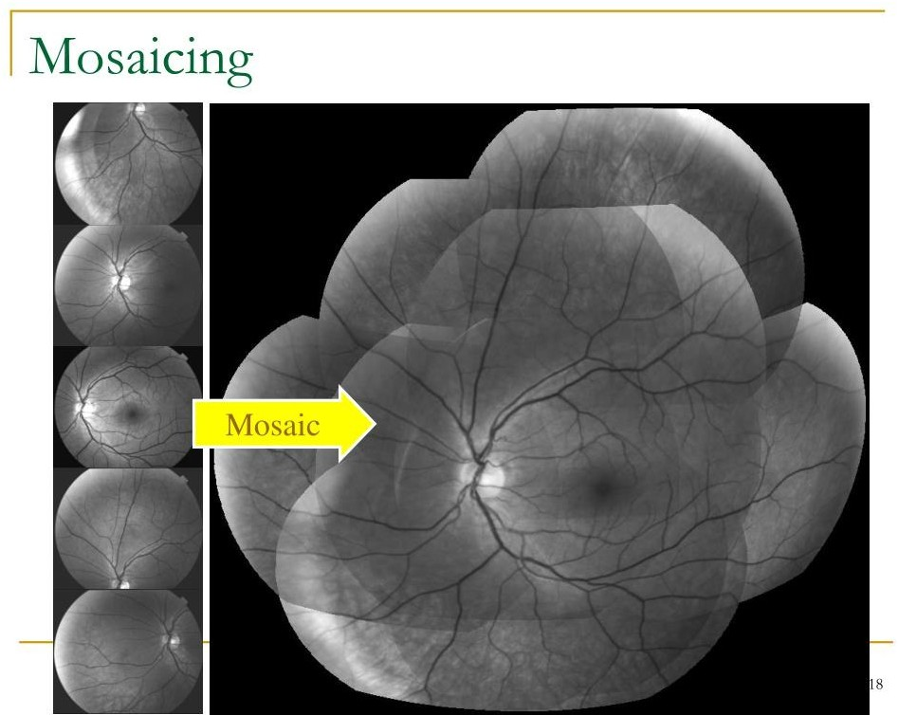

Slide 19
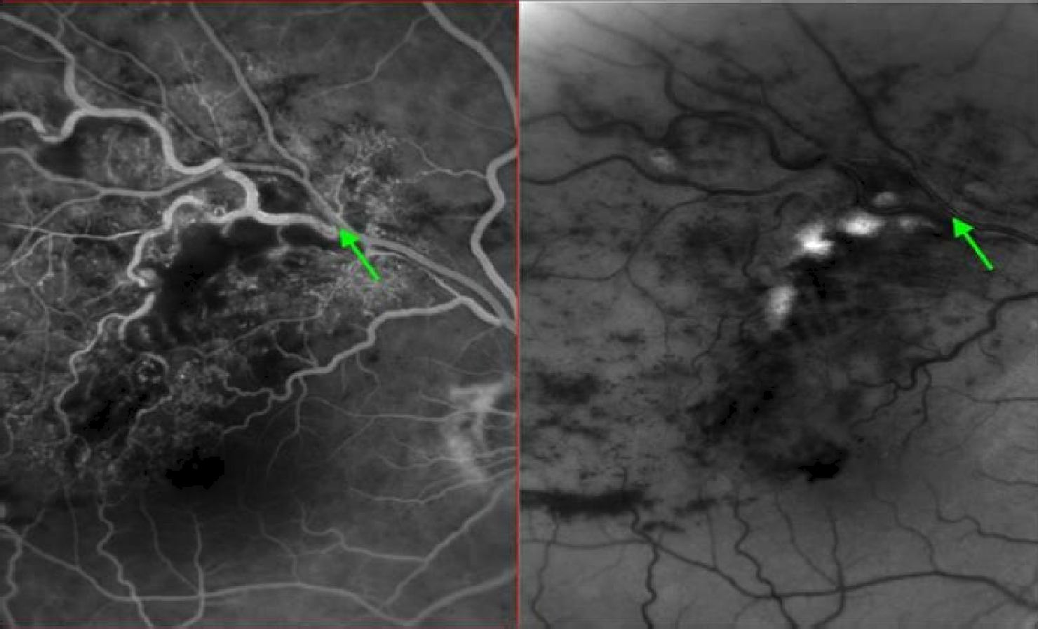
Fusion of medical information

Slide 20
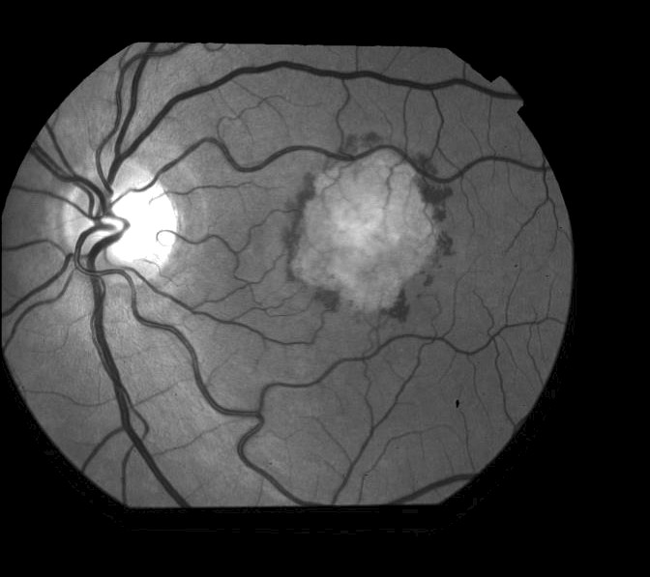
Change Detection
20

Slide 21
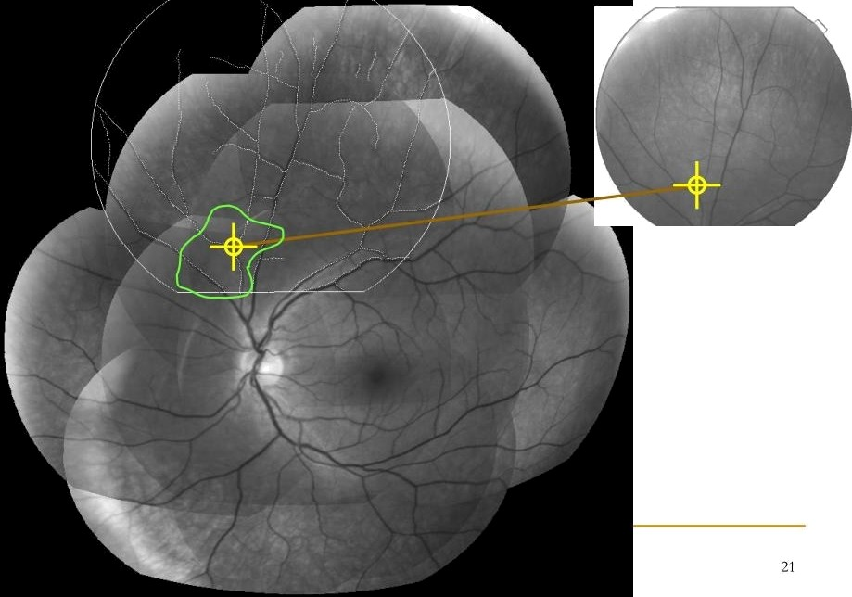
Computer—assisted surgery

Slide 22
What is needed?
A known transformation, which is less likely
OR
Computing the transformation from features.
a Feature extraction
u Features in correspondence u Transformation models
a Objective function

Slide 23
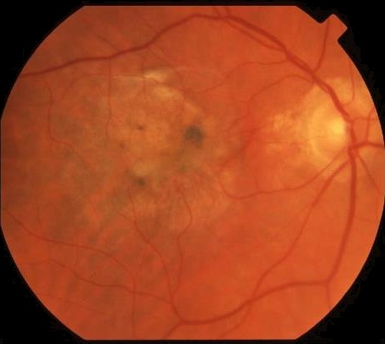
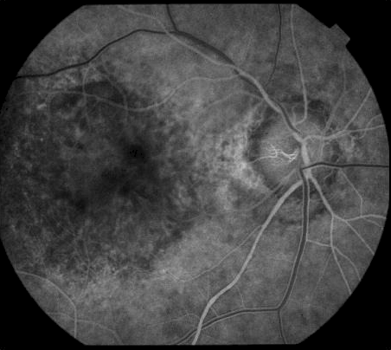
What might be a good feature?
Color slide
Fluorocein Angiogram

Slide 24
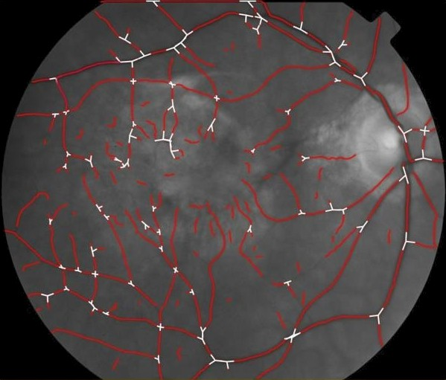
Feature Extraction

Slide 25
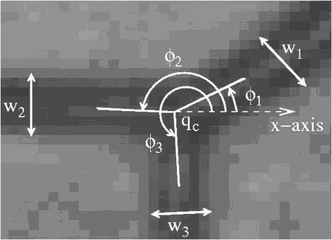
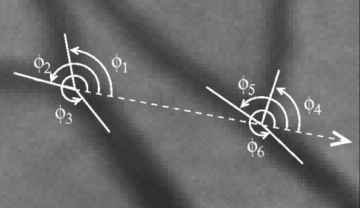
Features in Correspondence (crossover & branching points)

Slide 26
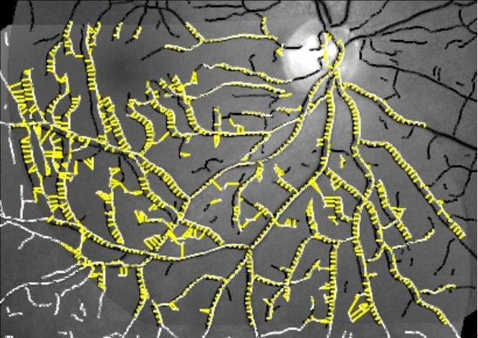
Features in Correspondence (vessel centerline points)

Slide 27
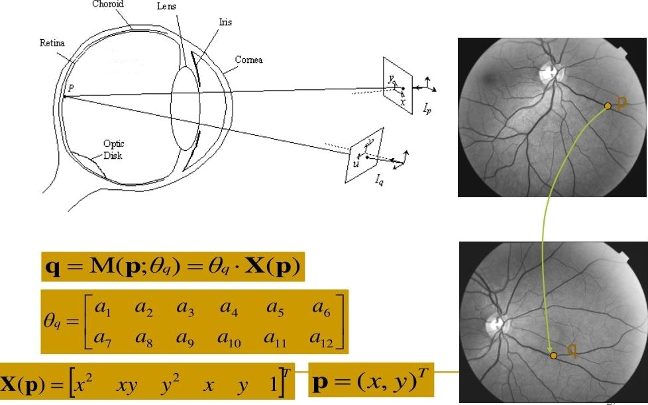
Transformańon Models

Slide 28
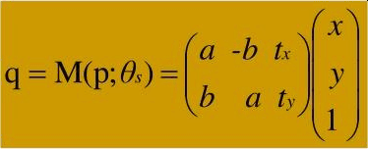


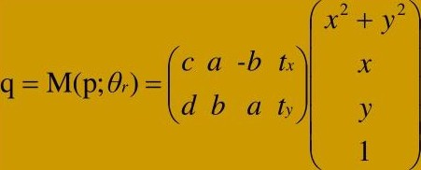
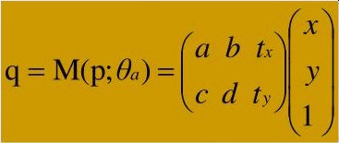



Transformation Model Hierarchy
2f›

Slide 29
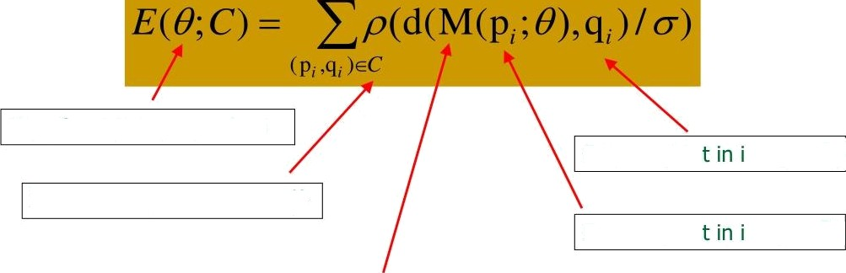
Objective Function
Transformation parameters
Feature poin
mage
Set of correspondences ( }
Feature poin
mage Jt›
Mapping of features from J/to J, based on @

Slide 30
